Slide 1

Knowledge Intensive Language Task
Kavin R V
19163
Adviser: Dr. Arpit Sharma (EECS), Dr. Jasbanta Patro

Slide 2
Motivation

Slide 3

Semi-Parametric Models
Main idea is instead of relying on either part these models combine both these knowledge base
DataBase
(Wikipedia, Documents..etc)
Answer
Search
Parametric Knowledge
Parametric Model
Top K
H6
(Non Parametric)
Non Parametric Knowledge

Slide 4
Research Gaps

Slide 5
Fusion in Decoder (FiD) Model
Encoder
Answer
(Autoregressively)
question:...
title:...
passage:...
Decoder
Encoder
Encoder
Used as key and value in decoder’s cross attention mechanism

Slide 6
Problems with FiD
Huge Models
(220M-11B!!!!)
Parameters
Encoder
40-100
Answer
(Autoregressively)
question:...
title:...
passage:...
Decoder
Encoder
Encoder
512
51200!

Slide 7
Objectives

Slide 8


Case Study of these Models on Compliance Documents
Hierarchical Architecture
Efficient Parameters
Modified FiD
Compliance Requirement
Novel 3 module Hierarchical Architecture for Robust extraction of answer in Multihop Question Answering
Analysed the effectiveness of different efficient parameter fine tuning techniques to be used in the bigger model
Apply some nove architectural changes and add the tested adapters to the FiD architecture
Run these model and analyse the results on a compiled list of questions from compliance Documents

Slide 9
Methodology

Slide 10


Dataset For Training the QA Systems
HotpotQA
Multihop Question Answering
Train: ~90k, Validation: ~7k
Two Settings: Fullwiki, Distractor
Two types: Bridge, Comparison
Three levels: Easy, Medium, Hard
Model
Model
All of wikipedia, documents

Slide 11

Main Columns in HotpotQA
Question
Answer
Contexts
Supporting
_________________________
_________________________

Slide 12
Baseline Model
Training:
Batch Size: 32
Learning Rate: 5e-5
Optimizer: AdamW
Epochs: 3
GPU: Tesla T4 16B
Module 1
(Selector)
C Sentence 1
Module 2
(Extractor)
Passage A
C Sentence 2
C Sentence 3
Passage B
C Sentence 3
Passage C
Answer
Passage C
C Sentence 4
Passage D
C Sentence 5
C Sentence 6
Seq2Seq Model (T5-squad)
(Generator)
Passage E
C Sentence 6
Passage F
H Sentence 1
Passage G
H Sentence 2
H Sentence 2
Passage H
Passage H
H Sentence 3
Q
C3
C6
H2
H6
Passage I
H Sentence 4
H Sentence 6
Passage J
H Sentence 5
H Sentence 6
Question
Question

Slide 13
Efficient Parameters
Adapters
Model
Model
QA
Dialogue
Model
Model
Fact Checking
Summarisation
Model
Model
RE
Translation

Slide 14
Efficient Parameters
Adapters
QA
Dialogue
Model
Fact Checking
Summarisation
RE
Translation

Slide 15
Efficient Parameters
Adapters
QA
Dialogue
Model
Fact Checking
Summarisation
RE
Translation

Slide 16
Efficient Parameters
Adapters
QA
Dialogue
Model
Fact Checking
Summarisation
RE
Translation

Slide 17
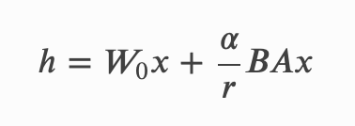
Efficient Parameters
Low Rank Adaptation(LoRA)
XW
W
Projection (h)
X

Slide 18
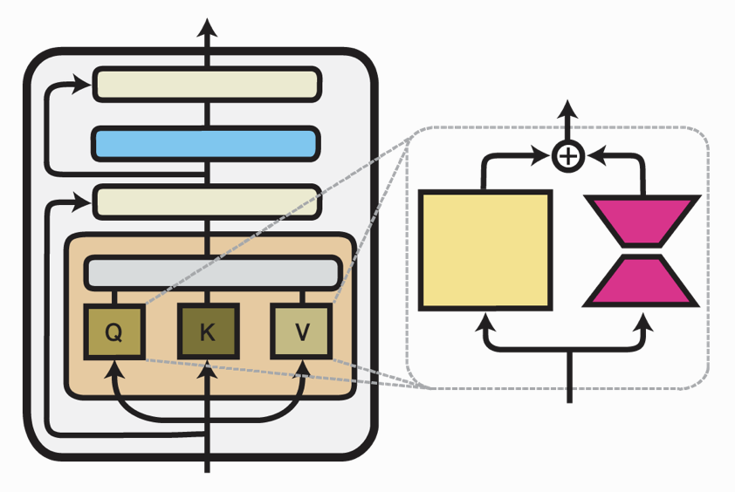
Efficient Parameters
Low Rank Adaptation(LoRA)
h
h1
h2
User Chosen
Hyperparameter
Usually 2r
W
B
Projection(h)
A
X
X

Slide 19
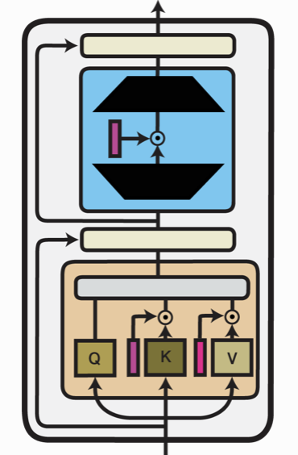
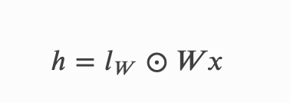
Efficient Parameters
Infused Adapter((IA)^3)
h
lw
W
Projection (h)
X

Slide 20
Efficient Parameters
h
h
h1
h2
lw
W
W
B
Projection (h)
Projection(h)
A
X
X
X

Slide 21
Efficient Parameters
→ Efficient to Train
→ task-specific modifications
→ Doesn’t require retaining of weight for individual tasks
h
h
h1
h2
lw
W
W
B
Projection (h)
Projection(h)
A
X
X
X

Slide 22
Efficient Parameters
Results on the Baseline Generator
 | Full fine-tune | LoRA(r=16) | LoRA(r=32) | LoRA(r=64) | LoRA(r=128) | (IA)^3
Trainable Parameters | ~60.5M | ~590k | ~1.18M | ~2.35M | ~4.75M | ~45k
Exact Match | 79.43 | 73.03 | 74.33 | 76.54 | 78.72 | 67.37
F1 Score | 85.97 | 79.86 | 81.32 | 82.95 | 84.86 | 72.48

Slide 23

Data Pre-processing for FiD
HPQA
10%
Database
BM25

Slide 24
Data Pre-processing for FiD
HPQA
5%
Database
BM25

Slide 25
FiD
Challenges:
220M parameters
90K+ training examples
Encoder output: 51200*768
16GB VRAM
No background Training
Encoder
Answer
(Autoregressively)
Decoder
Encoder
Encoder

Slide 26
Encoder Decoder Analogy
Encoder
Decoder

Slide 27
Encoder Decoder Analogy
Encoder
Decoder

Slide 28
FiD
Encoder
Answer
(Autoregressively)
Decoder
Encoder
Encoder

Slide 29
FiD-eff
Encoder
Answer
(Autoregressively)
Decoder
Encoder
Encoder

Slide 30
FiD-eff
Encoder
Answer
(Autoregressively)
Decoder
Encoder
Encoder

Slide 31
FiD Modifications
Encoder
Answer
(Autoregressively)
Decoder
Encoder
Encoder

Slide 32
FiD Modifications
Initialised with weights from model trained on Natural Questions
Encoder
Answer
(Autoregressively)
Decoder
Encoder
Encoder

Slide 33
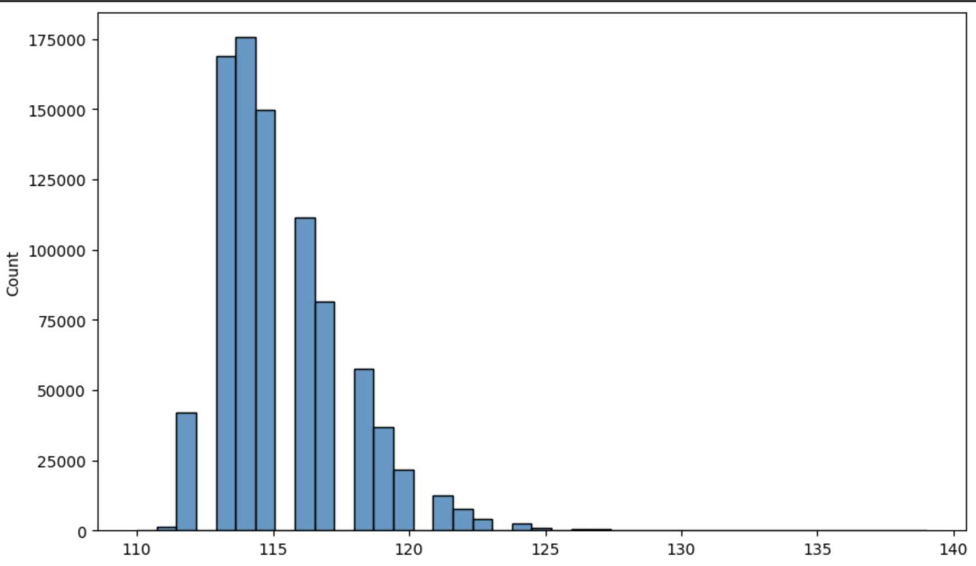
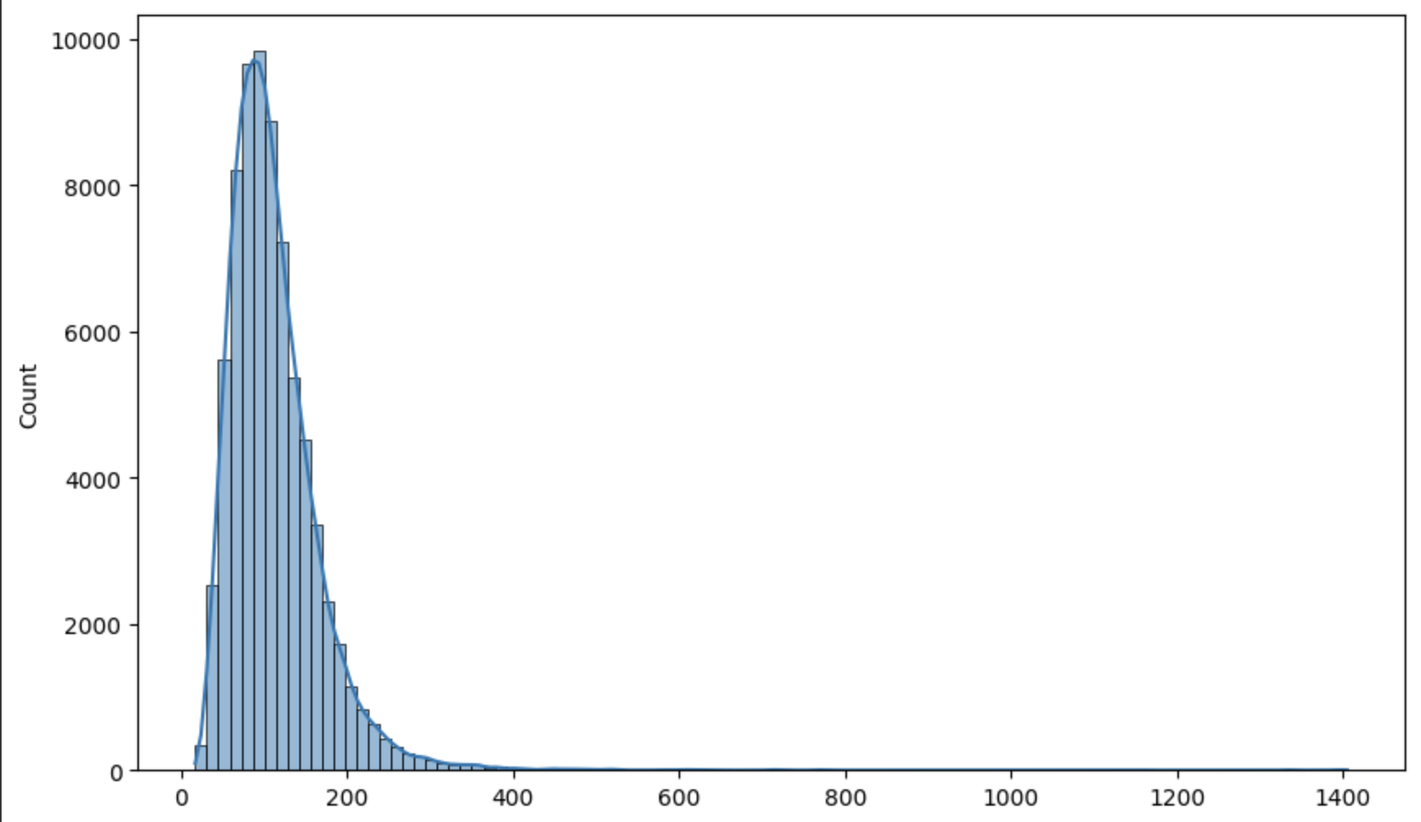
FiD-eff (Weights from FiD-NQ)
Results on NQQA and HpQA (F1/EM(Latency))
k | Full | 128 | 64 | 32 | 16
NQ(DPR) 10 Passages | 49.18/40.28 (8.28ms) | 49.18/40.28 (8ms) | 40.77/33.48 (7.56ms) | 27.71/20.91 (7.38ms) | 11.13/5.54 (7.26ms)
NQ(DPR) 25 Passages | 50.89/41.90 (24ms) | 50.89/41.90 (20ms) | 40.30/34.71 (18.8ms) | 30.31/23.11 (18.2ms) | 12.63/7.29 (18ms)
NQ(DPR) 50 Passages | 51.76/42.30 (48ms) | 51.76/42.30 (40ms) | 41.11/35.23 (39.2ms) | 31.25/23.89 (39ms) | 13.02/8.33 (38.9ms)
HpQA 10 Passages | 38.98/27.77 (17ms) | 37.80/26.97 (16.2ms) | 30.35/21.13 (15.6ms) | 18.24/11.51 (15.2ms) | 1.77/3.38 (15ms)

Slide 34
Encoder Decoder Analogy
Encoder
Decoder

Slide 35
Encoder Decoder Analogy
Encoder
Decoder

Slide 36
FiD-eff with convolution
Encoder
Answer
(Autoregressively)
Decoder
Encoder
Encoder

Slide 37
FiD-eff with convolution
Encoder
Answer
(Autoregressively)
Decoder
Encoder
Encoder

Slide 38
FiD-eff with convolution
Encoder
Answer
(Autoregressively)
Decoder
Encoder
Encoder
In my model it’s 32(yellow) + 16(Red) times n passages

Slide 39
FiD-eff with convolution
Encoder
Answer
(Autoregressively)
Decoder
Encoder
Encoder
48
4800

Slide 40
1D Convolution
Kernel Size: 64
Input channel: 768
Output channel: 768
Stride: 32
Kernel Size
Channel Size
Stride

Slide 41
FiD-eff with convolution
After adding Adapter LoRA(r=64) and (IA)^3
Number learnable parameters are ~9.3M
f
Encoder
Answer
768*512
(Autoregressively)
Decoder
Encoder
f
Training:
Batch Size: 2
Gradient Accumulation: 64
Learning Rate: 10e-4
Optimizer: AdamW
Gradient Steps: ~2.5K
Encoder
48
4800

Slide 42
Results and Discussion

Slide 43
FiD-eff with conv
Compared to SOTAs from KILT(HotpotQA)
 | F1 | EM
SEAL (generative)(2021) (11B) | 51.44 | 40.46
FiD with RS (200 passages)(2022) (11B) | 50.15 | 39.05
BART + DPR (100 passages)(2021) | 41.56 | 31.77
RAG (100 passages)(2021) (>3B) | 36.03 | 26.97
FiD-eff with conv (25 passages) (220M) (Ours) | 48.66 | 38.92

Slide 44
FiD-eff with conv
Pre-trained vs 10 vs 25 passages
 | F1 | EM
FiD-eff 32 without conv(25 passages) (220M)(FiD-NQ weights) | 18.24 | 11.51
FiD-eff 64 without conv(25 passages) (220M)(FiD-NQ weights) | 30.35 | 21.13
FiD-eff with conv (10 passages) (220M) (Ours) | 44.66 | 33.58
FiD-eff with conv (25 passages) (220M) (Ours) | 48.73 | 38.92

Slide 45
FiD-eff with conv
On different types of questions (10 Passages)
 | F1 | EM
Bridge | 62.22 | 56.56
Comparison | 40.25 | 27.80
Overall | 44.66 | 33.58

Slide 46
Baseline Model
Module 1: Passage Selector
 | F1 | EM
Easy | 91.81 | 74.73
Medium | 88.91 | 66.76
Hard | 87.13 | 63.82
Bridge | 87.32 | 62.67
Comparison | 97.34 | 90.78
Overall | 89.33 | 68.03

Slide 47
Baseline Model
Module 2: Sentence Extractor
 | F1 | EM
Easy | 85.32 | 55.21
Medium | 86.32 | 53.51
Hard | 82.93 | 46.84
Bridge | 84.03 | 47.98
Comparison | 91.53 | 72.22
Overall | 85.56 | 52.73

Slide 48
Baseline Model
Module 3: Answer Generator
 | F1 | EM
Easy | 83.55 | 74.16
Medium | 90.19 | 86.23
Hard | 73.51 | 59.69
Bridge | 88.53 | 81.29
Comparison | 75.45 | 71.83
Overall | 85.97 | 79.43

Slide 49
Baseline Model
Overall
 | F1 | EM
Easy | 83.55 | 74.16
Medium | 90.19 | 86.23
Hard | 73.51 | 59.69
Bridge | 88.53 | 81.29
Comparison | 75.45 | 71.83
Overall | 60.56 | 48.32

Slide 50
Conclusion

Slide 51
Adapters Were Quite Effective on both baseline and FiD-eff
Model’s performance improved quite significantly from the pre-trained model
Model’s performance on COREQQA is as good as Baseline but also Reasonably has low latency

Slide 52
References
KILT: a Benchmark for Knowledge Intensive Language Tasks
Retrieval-Augmented Generation for Knowledge-Intensive NLP Tasks
Leveraging Passage Retrieval with Generative Models for Open Domain Question Answering
Autoregressive Search Engines: Generating Substrings as Document Identifiers
Generative Multi-hop Retrieval
Autoregressive Entity Retrieval
HOTPOTQA: A Dataset for Diverse, Explainable Multi-hop Question Answering
TriviaQA: A Large Scale Distantly Supervised Challenge Dataset for Reading Comprehension
FEVER: a large-scale dataset for Fact Extraction and VERification
Zero-Shot Relation Extraction via Reading Comprehension
T-REx: A Large Scale Alignment of Natural Language with Knowledge Base Triples
Automated Question Answering for Improved Understanding of Compliance Requirements: A Multi-Document Study
Automated Generating Natural Language Requirements based on Domain Ontology
Talk on Generative Search Engines, By Dr. Minjoo Seo, Professor, KAIST
Natural Questions: A Benchmark for Question Answering Research

